Slide 1
Transformer & BERT
Review by Hyunwoong (github.com/gusdnd852)

Slide 2
Presentation Outline
The Transformer Network (Backbone of BERT)
1.1 Attention Mechanism (Seq2Seq with Attention)
1.2 Transformer Architecture (Transformer)
Background : emergence of BERT (Introduction & Related Work)
2.1 Word Embedding (Word Representation in ML)
2.2 Embedding from Language Model (ELMo)
2.3 Unsupervised Pre-train, Supervised Fine Tune (GPT)
BERT & Experiment (Proposed Method & Experimental Result)

Slide 3
1.1 Attention Mechanism (Seq2Seq with Attention)

Slide 4
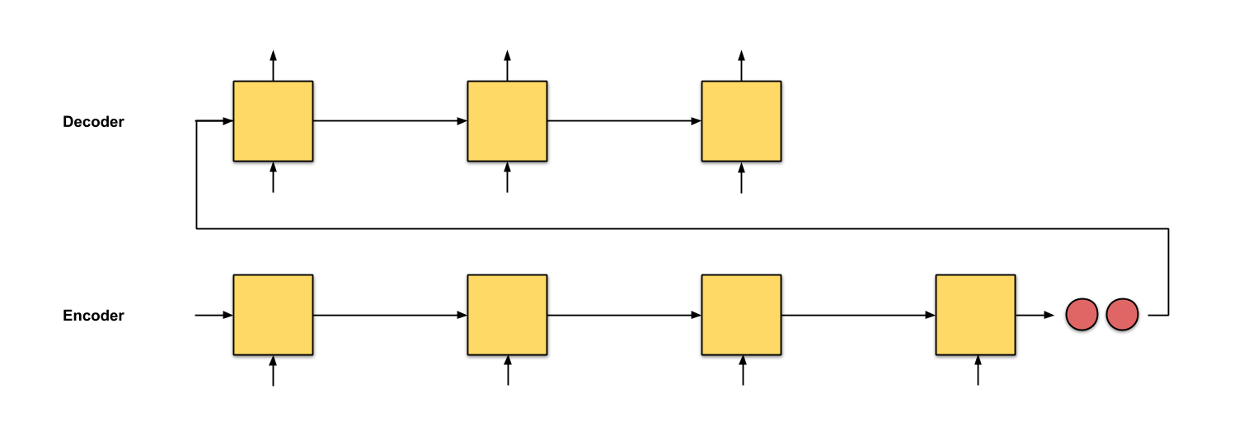
Reference : Raimi Karim
1.1 Attention Mechanism (Seq2Seq with Attention)
There are plain Seq2Seq model

Slide 5
Reference : Raimi Karim
1.1 Attention Mechanism (Seq2Seq with Attention)
If sequence is long, it shows very bad performance
But, Why?

Slide 6
Reference : Raimi Karim
1.1 Attention Mechanism (Seq2Seq with Attention)
Context vector size is fixed, we can not put every information

Slide 7
Reference : Raimi Karim
1.1 Attention Mechanism (Seq2Seq with Attention)
Network confused.
“so many information in small vector. which part is important?”

Slide 8
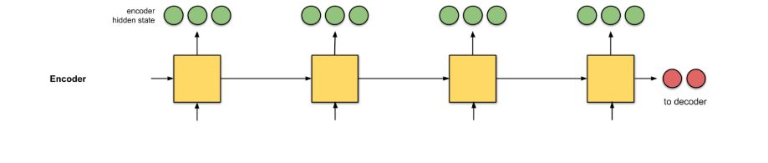
Reference : Raimi Karim
1.1 Attention Mechanism (Seq2Seq with Attention)
So, We will use output of each time step

Slide 9
Reference : Raimi Karim
1.1 Attention Mechanism (Seq2Seq with Attention)
Firstly, we can get the encoder hidden state

Slide 10
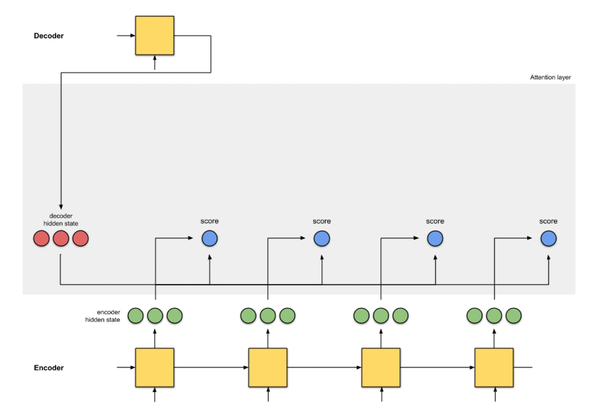
Reference : Raimi Karim
1.1 Attention Mechanism (Seq2Seq with Attention)
And, compute dot product of encoder hidden state and
output of decoder(firstly, BOS’s output) to get relationship of words

Slide 11
Reference : Raimi Karim
1.1 Attention Mechanism (Seq2Seq with Attention)
We call this framework as Query, Key, Value

Slide 12
Reference : Raimi Karim
1.1 Attention Mechanism (Seq2Seq with Attention)
Query
Key
Key
Key
Key

Slide 13
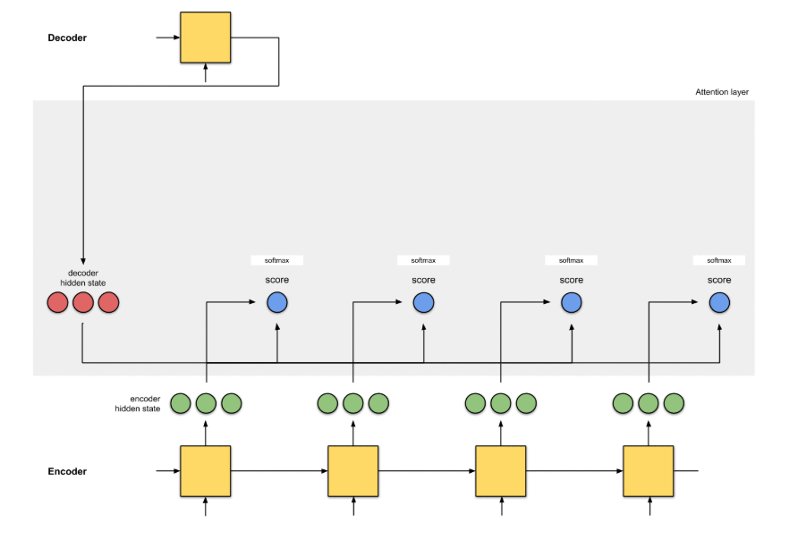
Reference : Raimi Karim
1.1 Attention Mechanism (Seq2Seq with Attention)
Query
Key
Key
Key
Key
And compute softmax score to adjust dot product to [0,1]

Slide 14
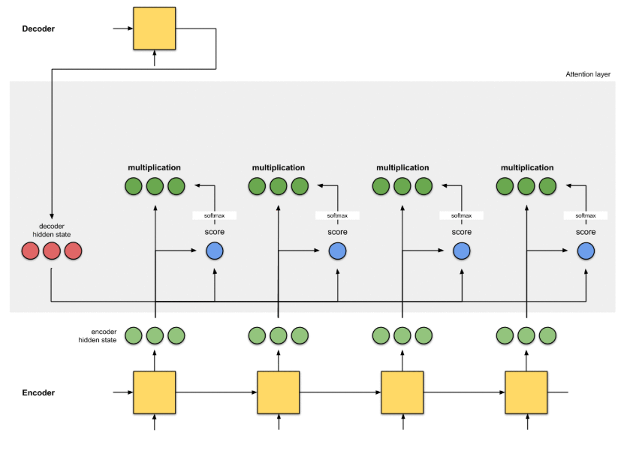
Reference : Raimi Karim
1.1 Attention Mechanism (Seq2Seq with Attention)
Value
Value
Value
Value
Query
Key
Key
Key
Key
Multiply score with keys (hidden state of encoders)

Slide 15
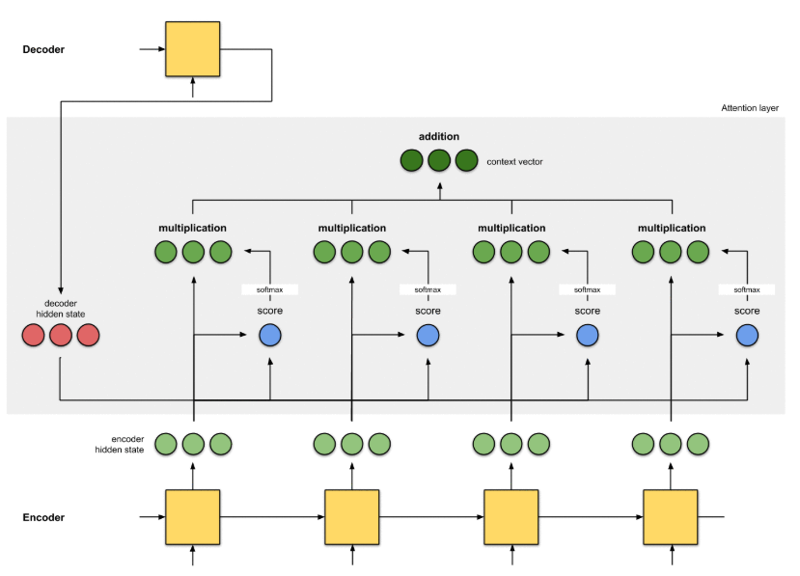
Reference : Raimi Karim
1.1 Attention Mechanism (Seq2Seq with Attention)
Align (attention)
Value
Value
Value
Value
Query
Key
Key
Key
Key
Add Every Value. Now we call this Align (Attention)

Slide 16
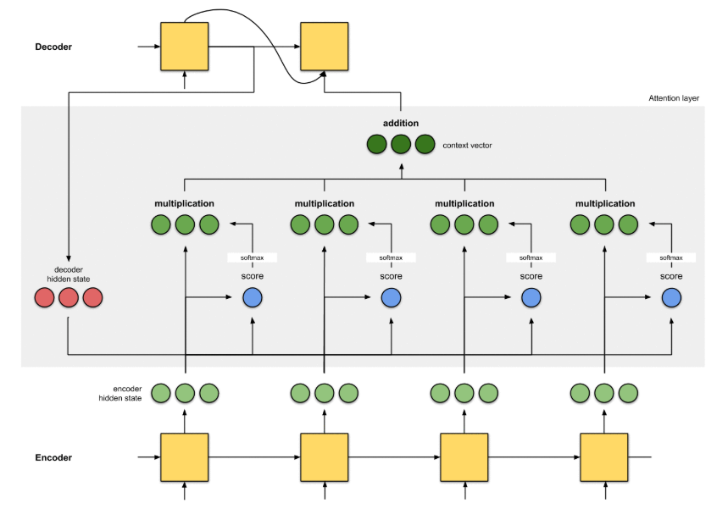
Reference : Raimi Karim
1.1 Attention Mechanism (Seq2Seq with Attention)
Align (Attention) is used as input

Slide 17
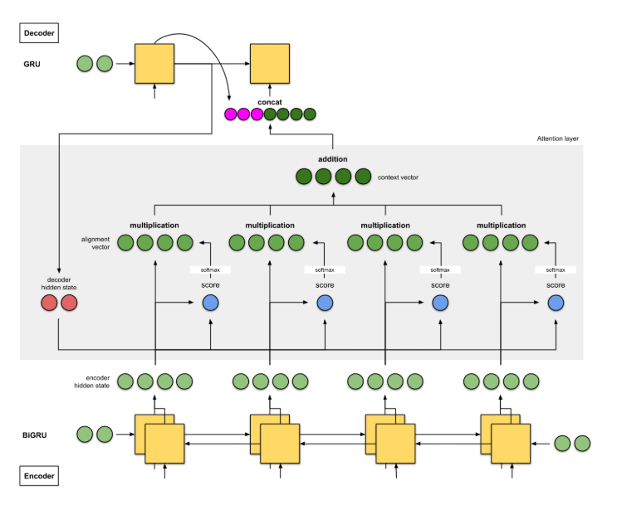
Reference : Raimi Karim
1.1 Attention Mechanism (Seq2Seq with Attention)
NMT by jointly learning and align (2014)
Align (Attention) is used as input

Slide 18
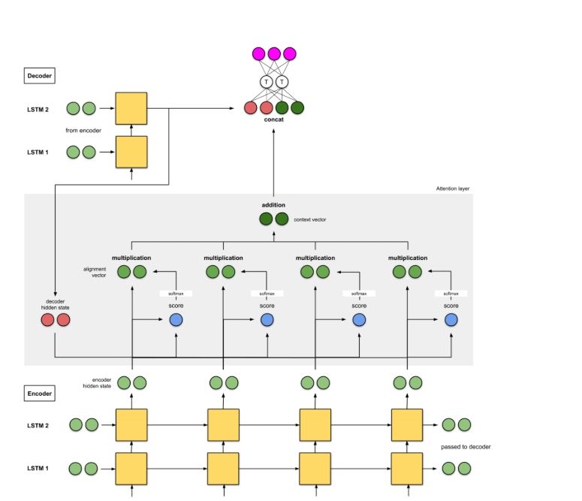
Reference : Raimi Karim
1.1 Attention Mechanism (Seq2Seq with Attention)
Effective Approaches to Attention-based NMT (2015)
Align (Attention) is used as input

Slide 19
1.2 Transformer Architecture

Slide 20
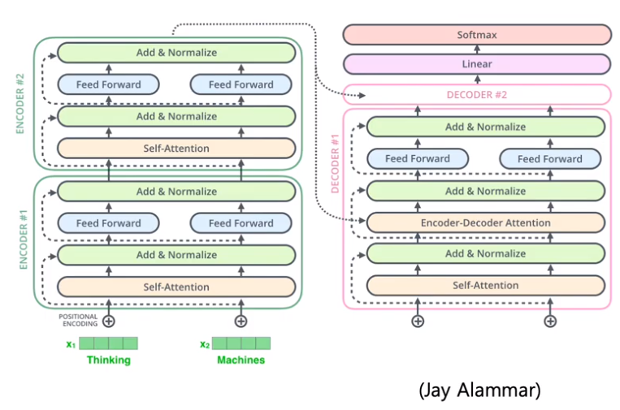
1.2 Transformer Architecture
Parallelism (Recurrent to Pos Encoding)
Consider self attention (not only enc-dec attention)

Slide 21
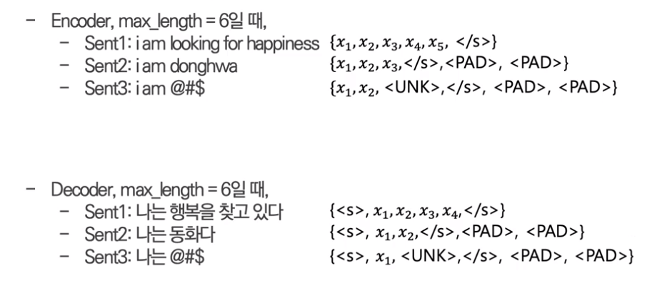
Reference : Kim Dong Hwa
1.2 Transformer Architecture
Input data format.
There are <s></s><PAD><UNK> tokens (max_len = 6)

Slide 22
Reference : Kim Dong Hwa
1.2 Transformer Architecture
Input data format.
Data size is like this (zero initialized)
d_model = 4, max_len = 6
I : [0, 0, 0, 0]
am : [0, 0, 0, 0]
kim : [0, 0, 0, 0]
<PAD> : [0, 0, 0, 0]
<PAD> : [0, 0, 0, 0]
<PAD> : [0, 0, 0, 0]
data = torch.zeros(batch_size, max_len, d_model)
size = data.size() # [?, 6, 4]
? Is batchsize (number of sentence in here)

Slide 23
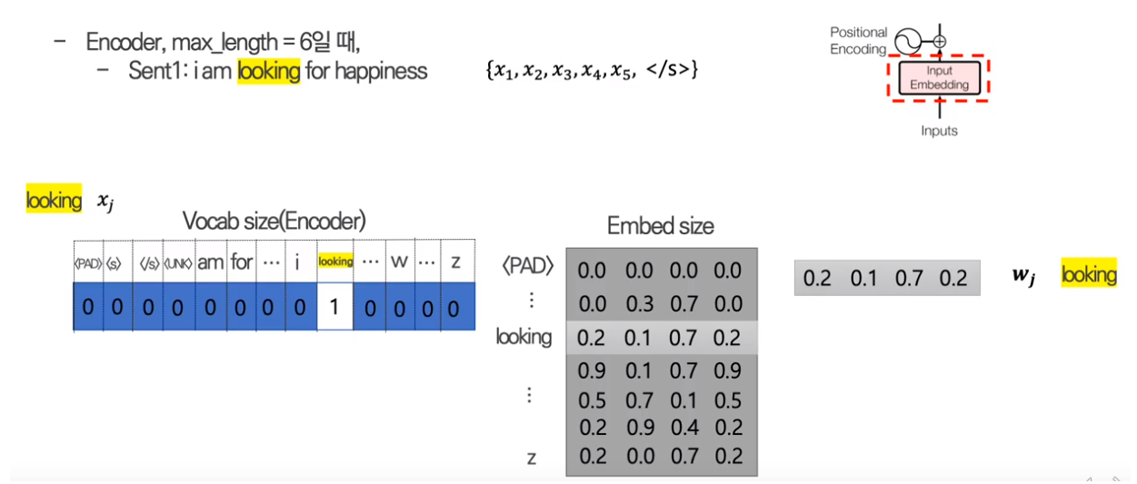
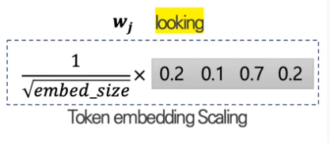
Reference : Kim Dong Hwa
1.2 Transformer Architecture
Input Embedding
nn.Embedding(vocab_size, d_model) work like this

Slide 24
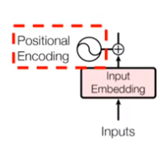
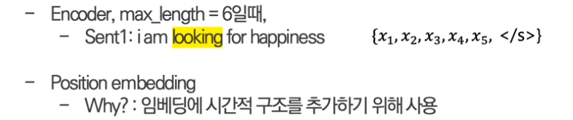
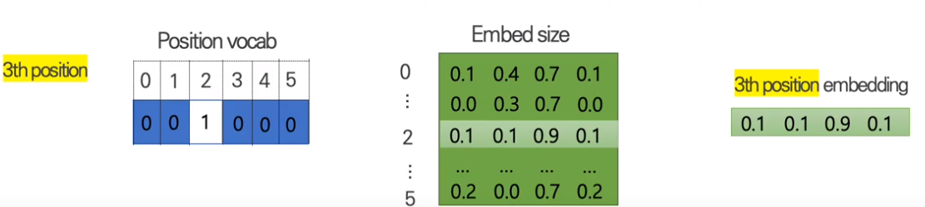
Reference : Kim Dong Hwa
1.2 Transformer Architecture
Positional Encoding
Pos Encoding – 1 (Weight Matrix)

Slide 25
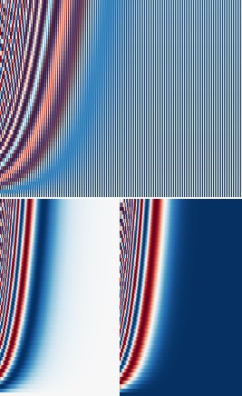
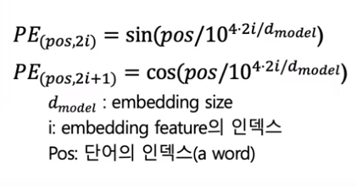
Reference : Kim Dong Hwa
1.2 Transformer Architecture
Positional Encoding
Pos Encoding – 2 (Sinusoid Function)

Slide 26
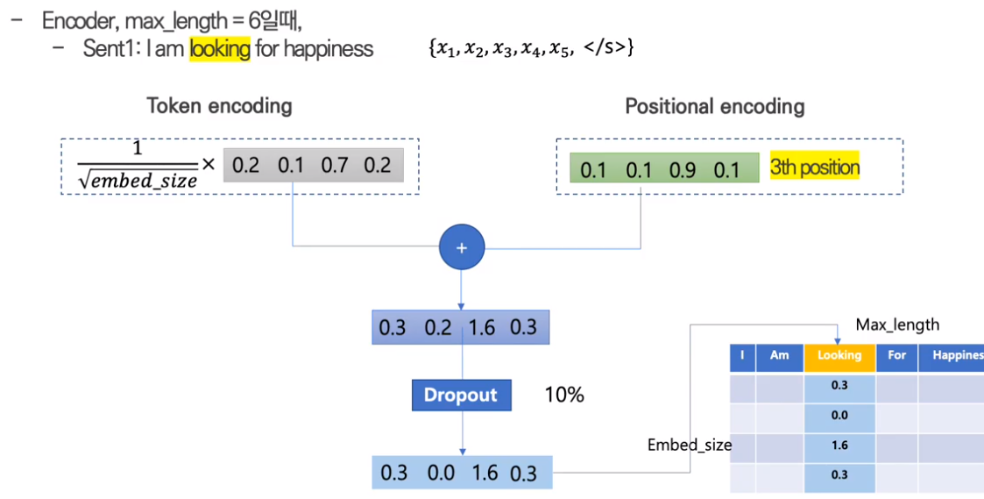
Reference : Kim Dong Hwa
1.2 Transformer Architecture
Embedding Dropout

Slide 27
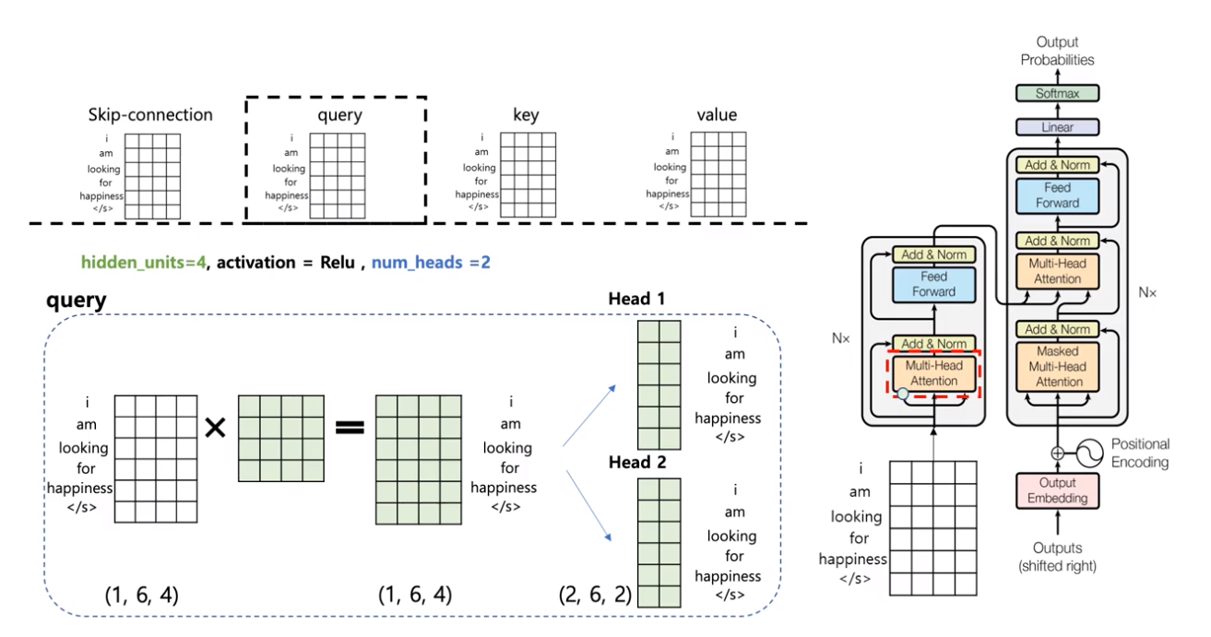
Reference : Kim Dong Hwa
1.2 Transformer Architecture
Multi-Head Attention

Slide 28
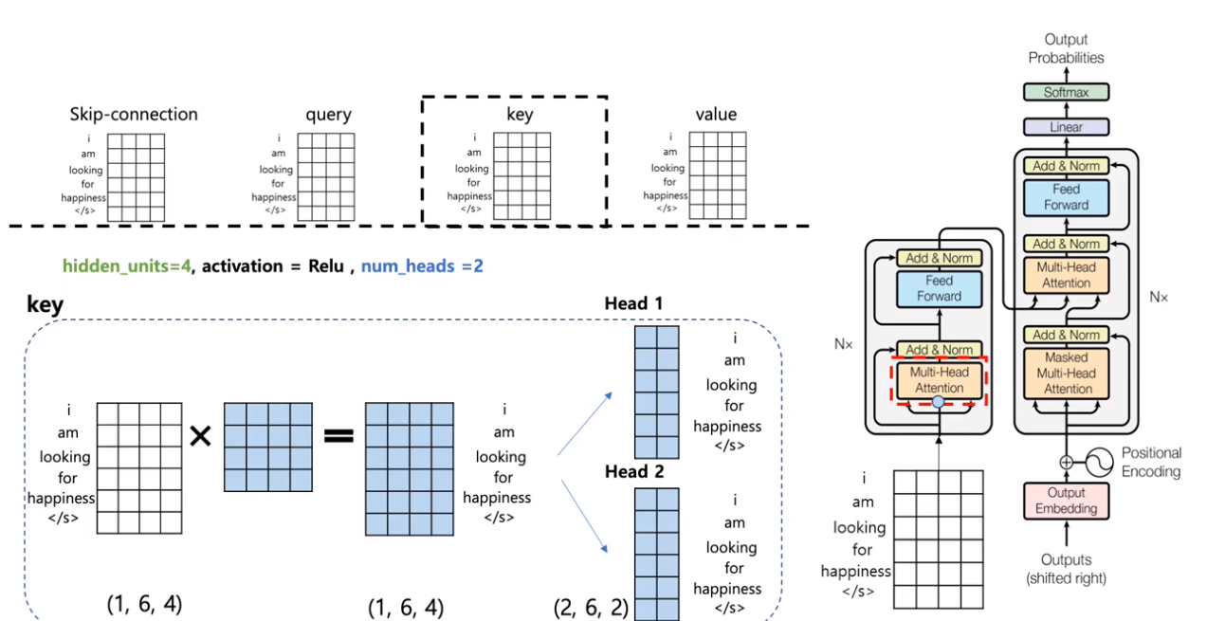
Reference : Kim Dong Hwa
1.2 Transformer Architecture
Multi-Head Attention

Slide 29
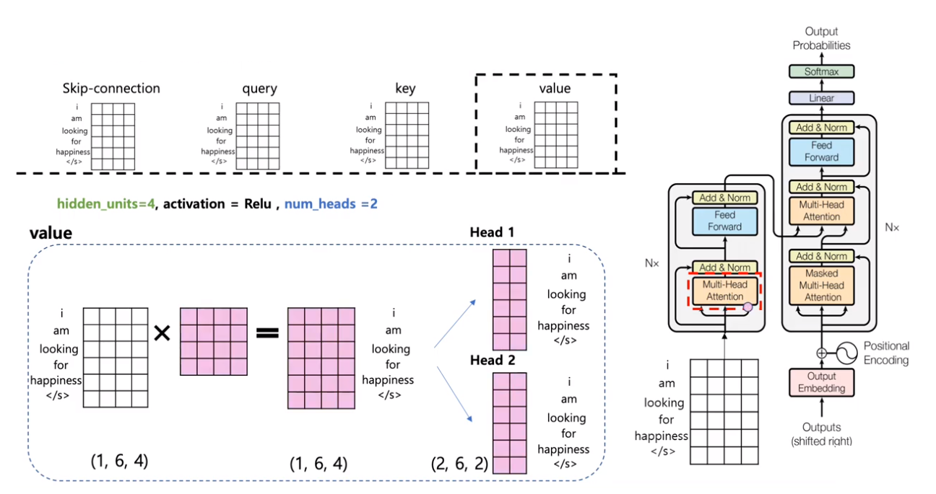
Reference : Kim Dong Hwa
1.2 Transformer Architecture
Multi-Head Attention

Slide 30
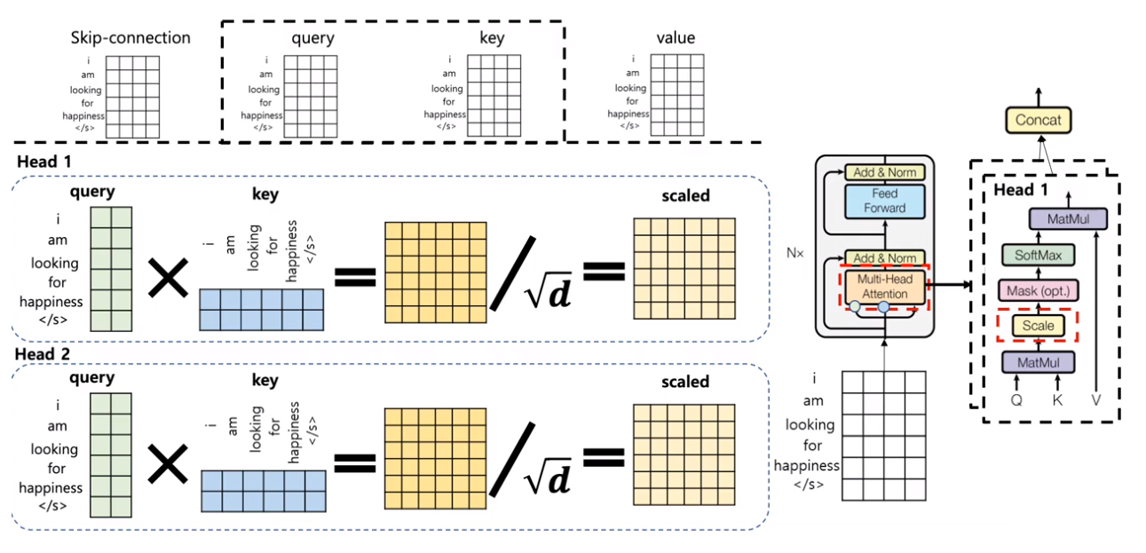
Reference : Kim Dong Hwa
1.2 Transformer Architecture
Multi-Head Attention

Slide 31
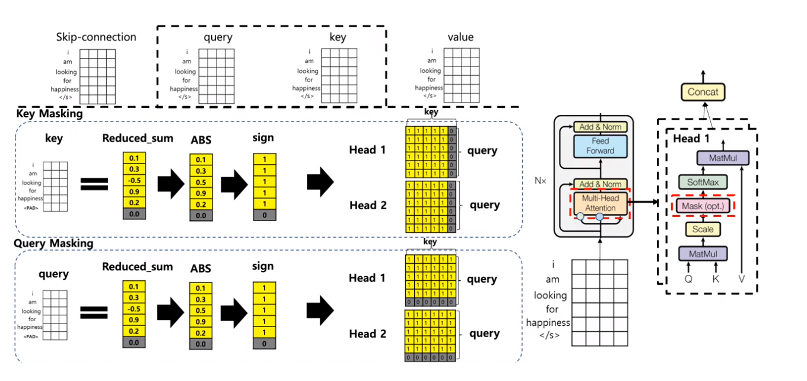
Reference : Kim Dong Hwa
1.2 Transformer Architecture
Multi-Head Attention (Apply Mask)

Slide 32
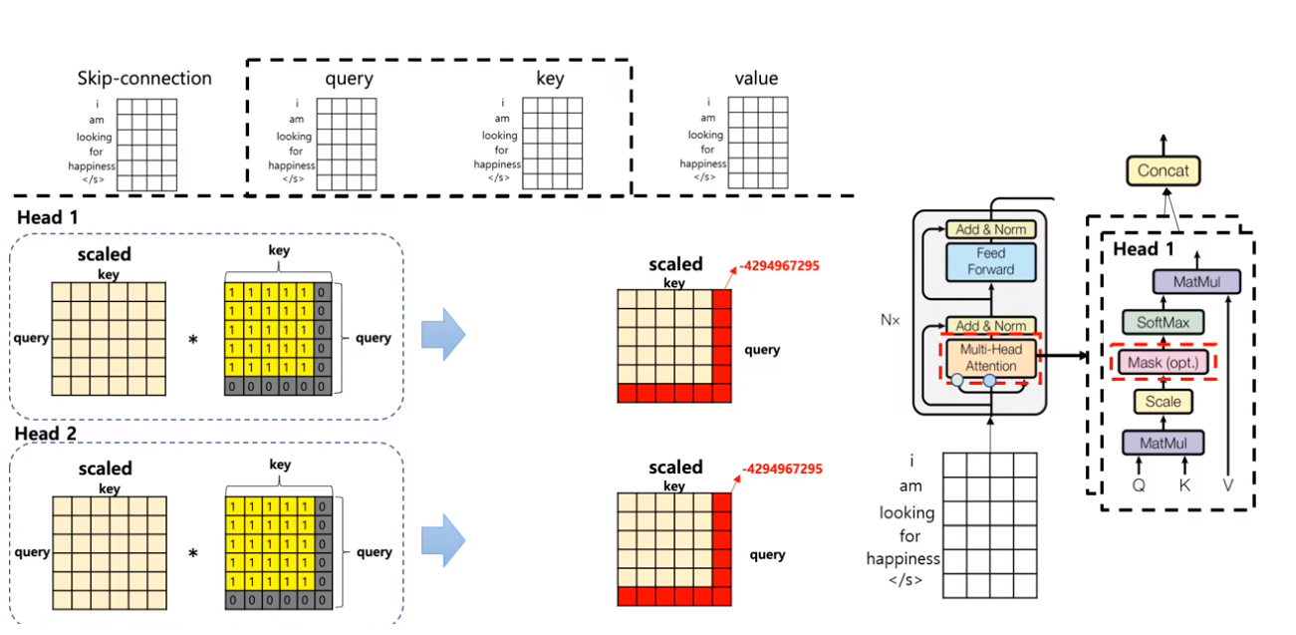
Reference : Kim Dong Hwa
1.2 Transformer Architecture
Multi-Head Attention (Apply Mask)

Slide 33
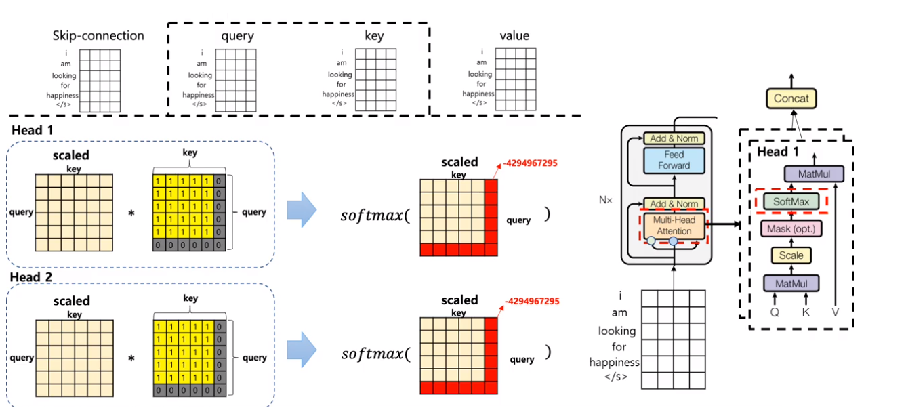
Reference : Kim Dong Hwa
1.2 Transformer Architecture
Multi-Head Attention (Apply Mask)

Slide 34
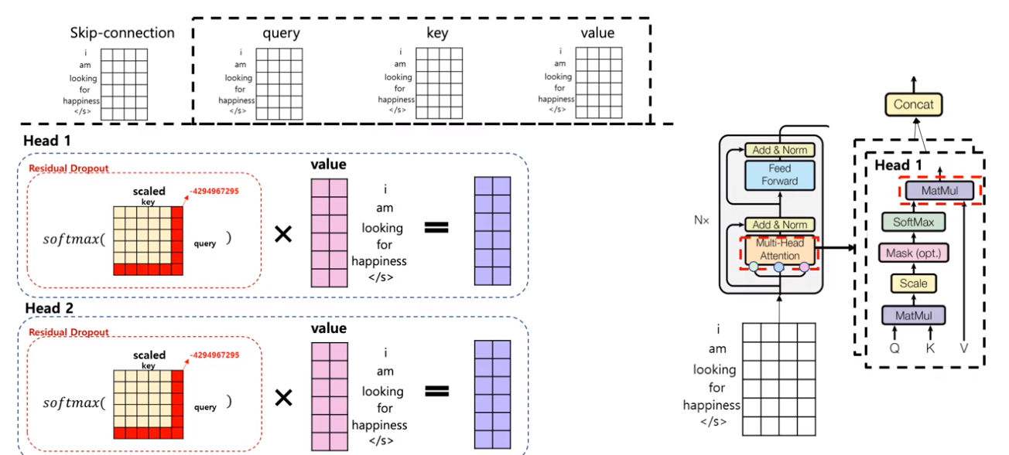
Reference : Kim Dong Hwa
1.2 Transformer Architecture
Multi-Head Attention

Slide 35
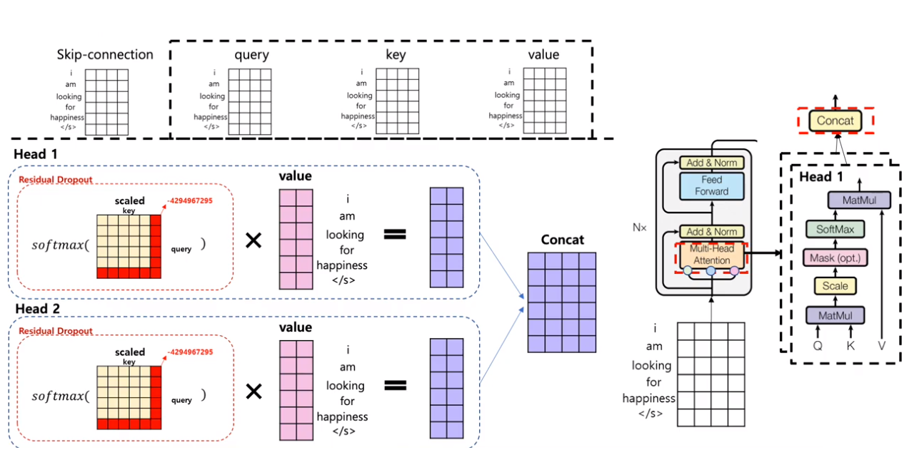
Reference : Kim Dong Hwa
1.2 Transformer Architecture
Multi-Head Attention

Slide 36
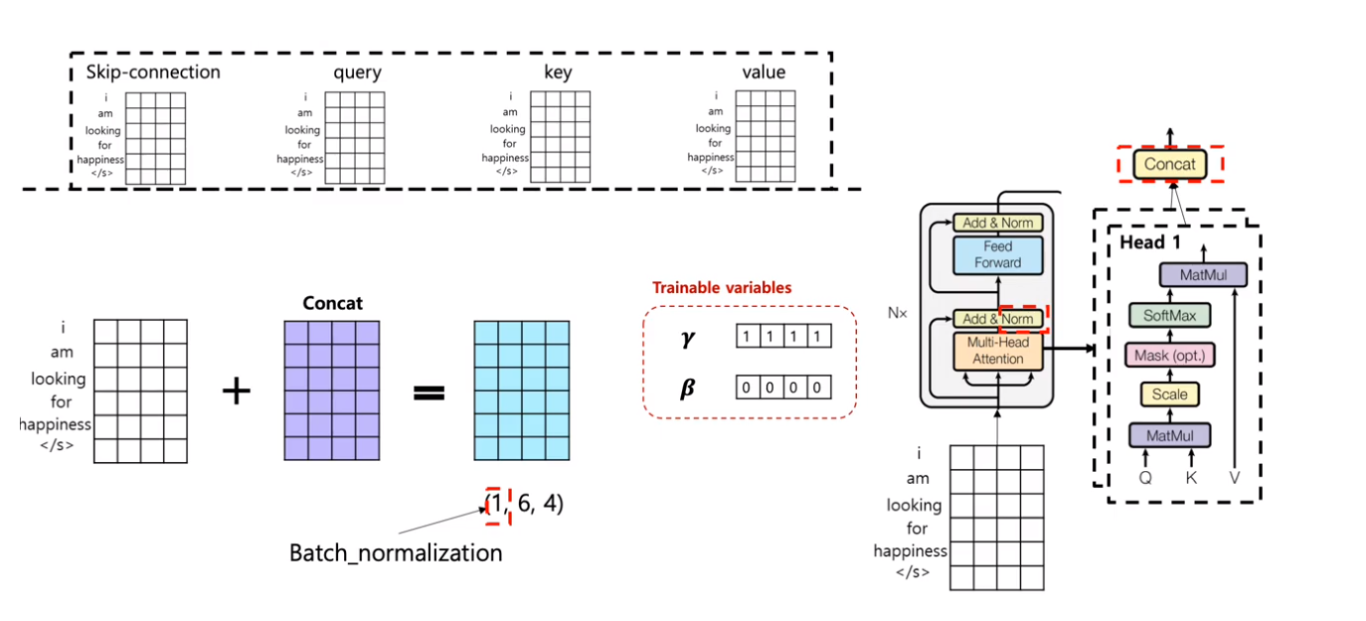
Reference : Kim Dong Hwa
1.2 Transformer Architecture
Add & Norm

Slide 37
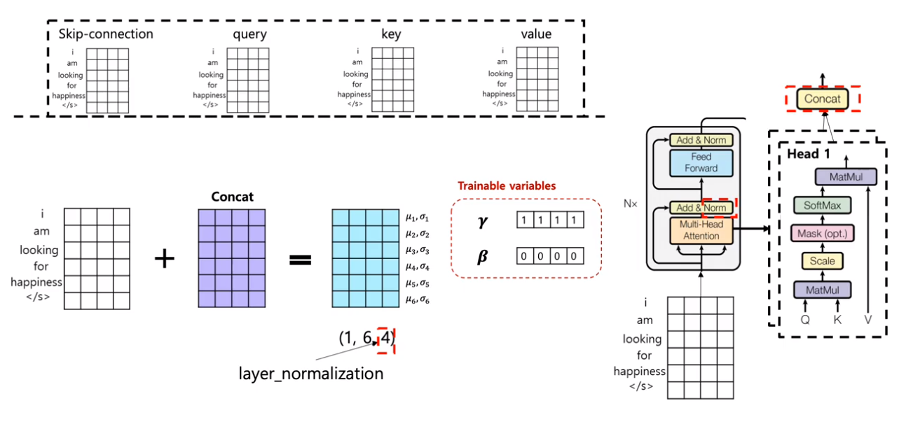
Reference : Kim Dong Hwa
1.2 Transformer Architecture
Add & Norm

Slide 38
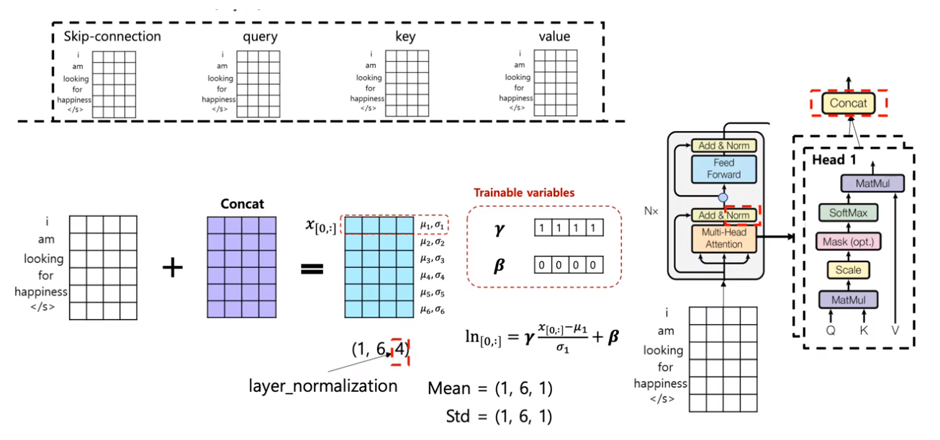
Reference : Kim Dong Hwa
1.2 Transformer Architecture
Add & Norm

Slide 39
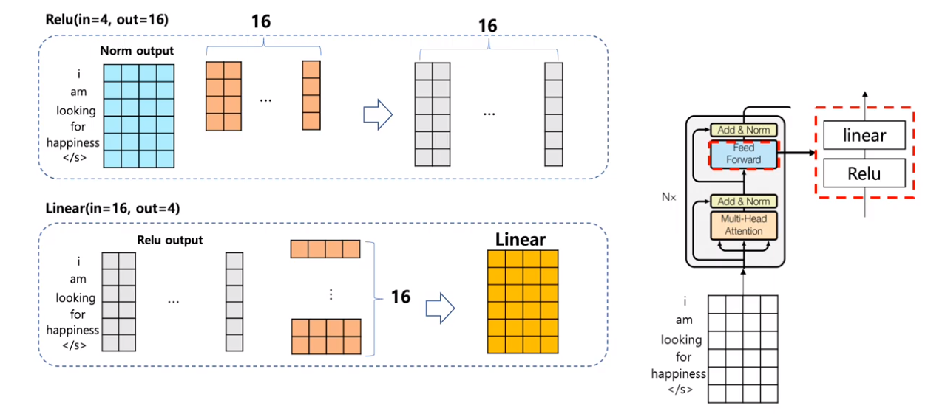
Reference : Kim Dong Hwa
1.2 Transformer Architecture
Positionwise Feed Foward

Slide 40
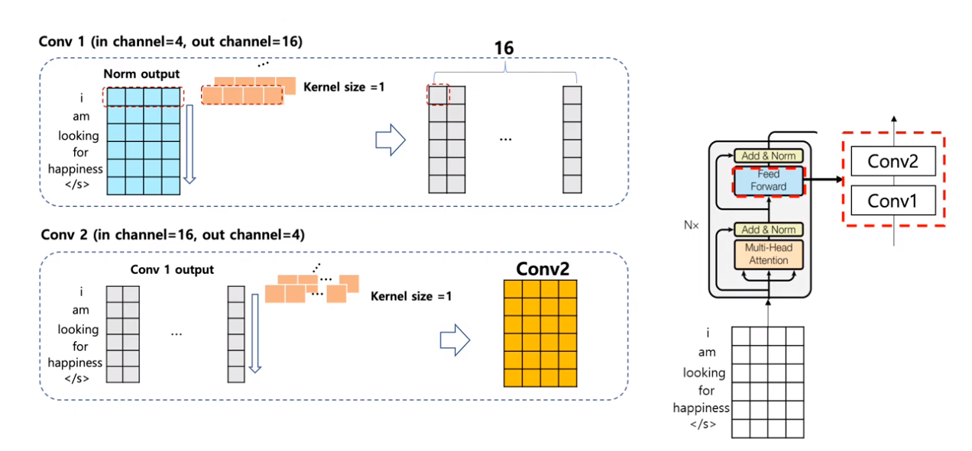
Reference : Kim Dong Hwa
1.2 Transformer Architecture
Positionwise Feed Foward

Slide 41
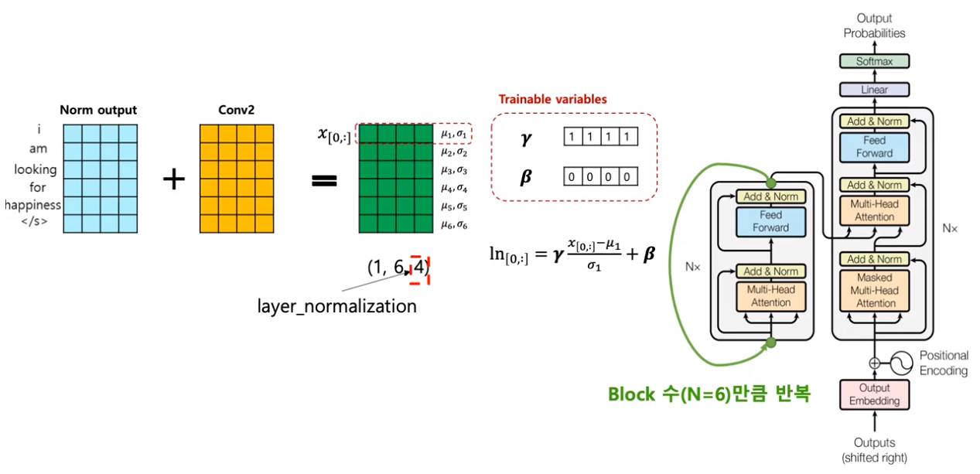
Reference : Kim Dong Hwa
1.2 Transformer Architecture
Add & Norm

Slide 42
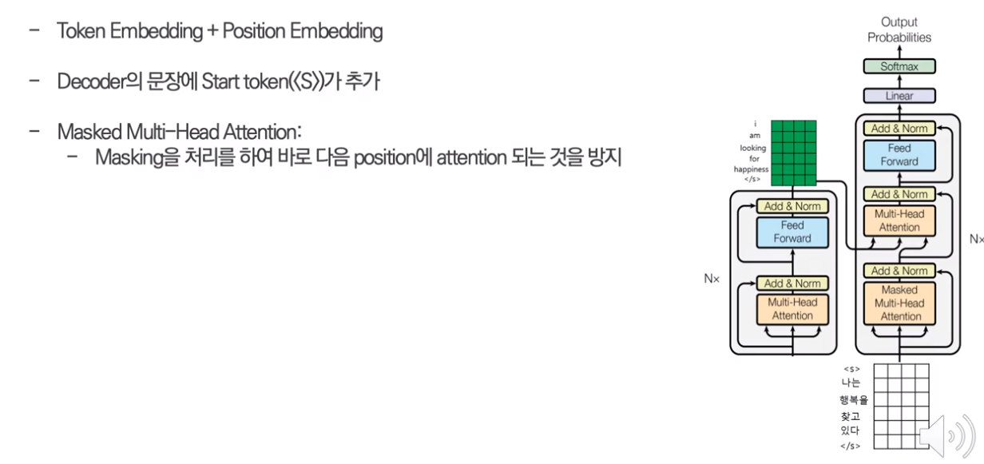
Reference : Kim Dong Hwa
1.2 Transformer Architecture
Decoder

Slide 43
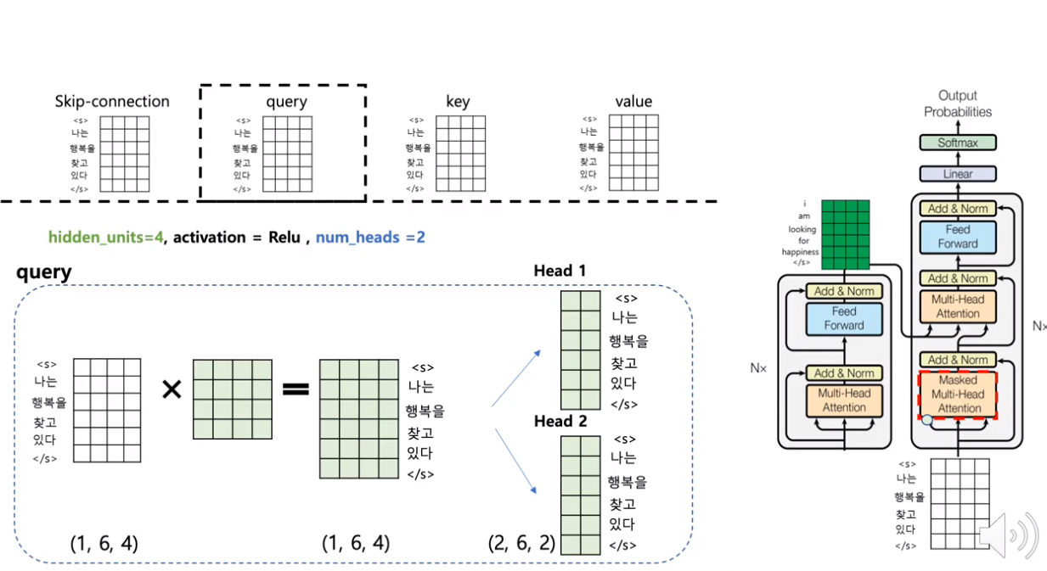
Reference : Kim Dong Hwa
1.2 Transformer Architecture
Masked Multi-Head Attention

Slide 44
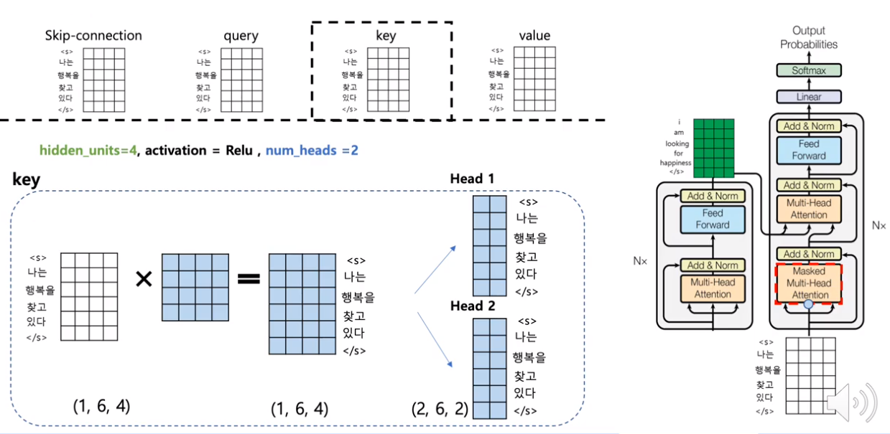
Reference : Kim Dong Hwa
1.2 Transformer Architecture
Masked Multi-Head Attention

Slide 45
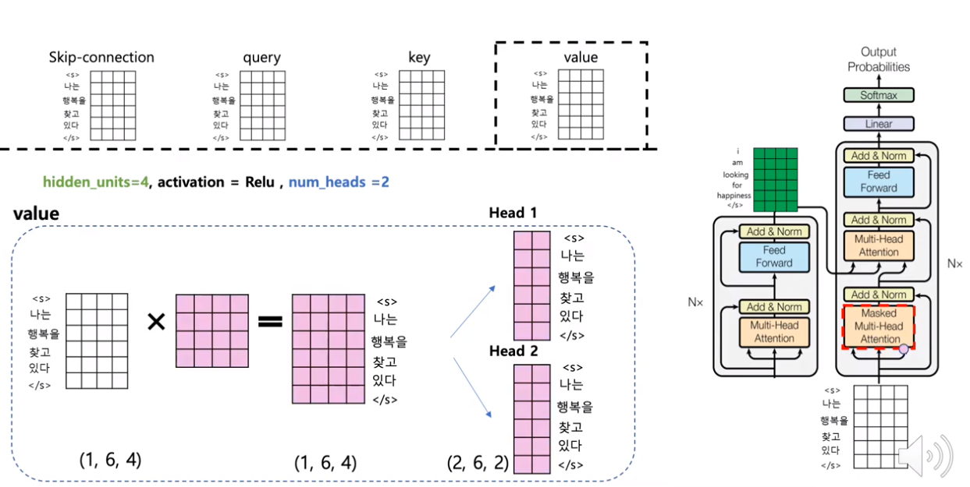
Reference : Kim Dong Hwa
1.2 Transformer Architecture
Masked Multi-Head Attention

Slide 46
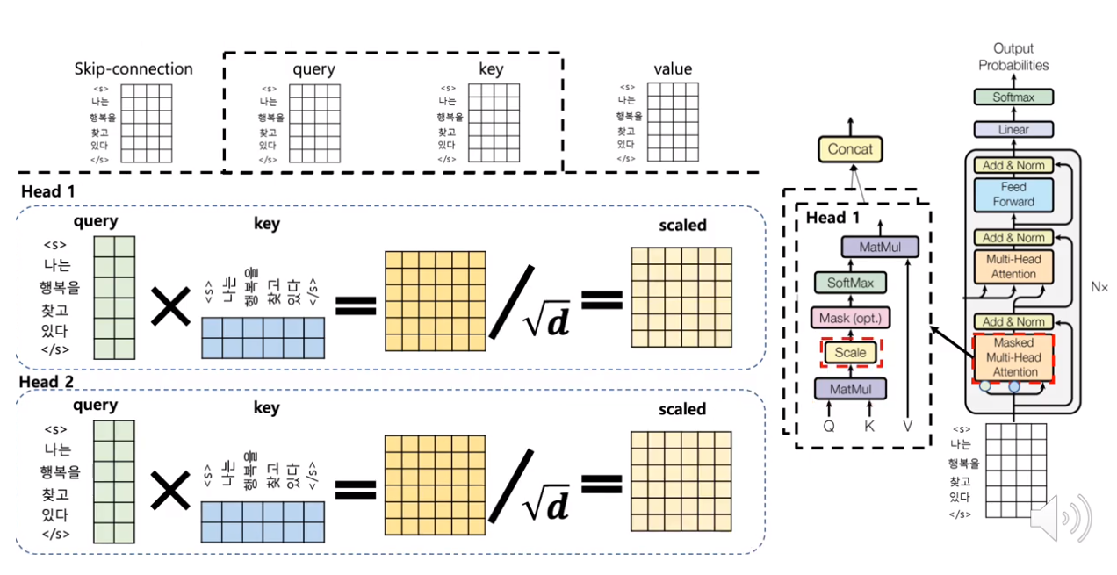
Reference : Kim Dong Hwa
1.2 Transformer Architecture
Masked Multi-Head Attention

Slide 47
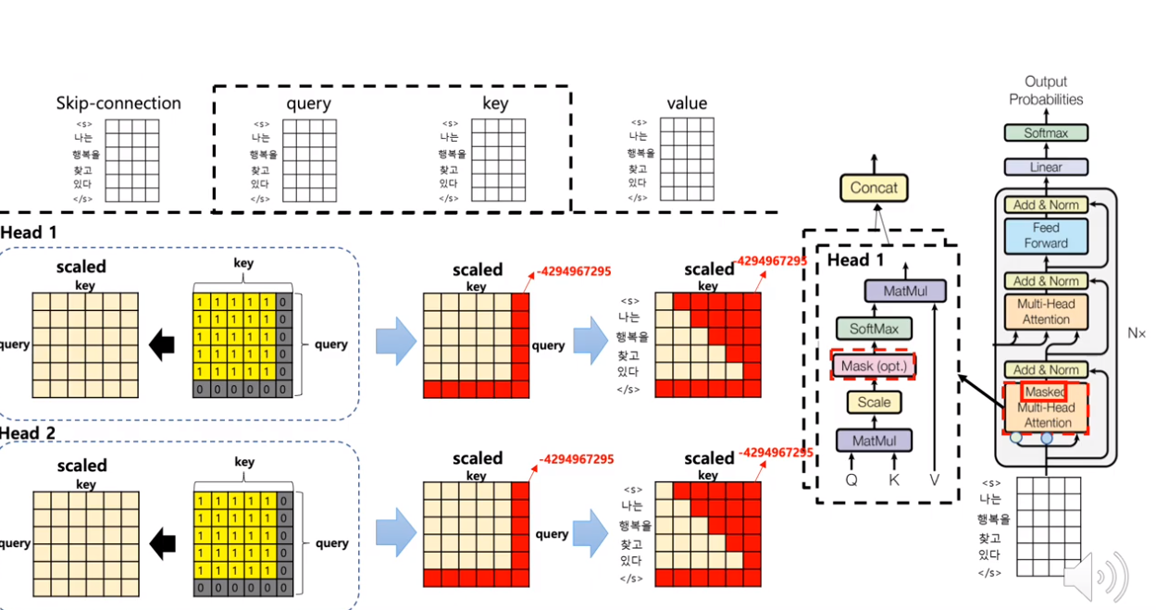
Reference : Kim Dong Hwa
1.2 Transformer Architecture
Masked Multi-Head Attention (Apply Mask)

Slide 48
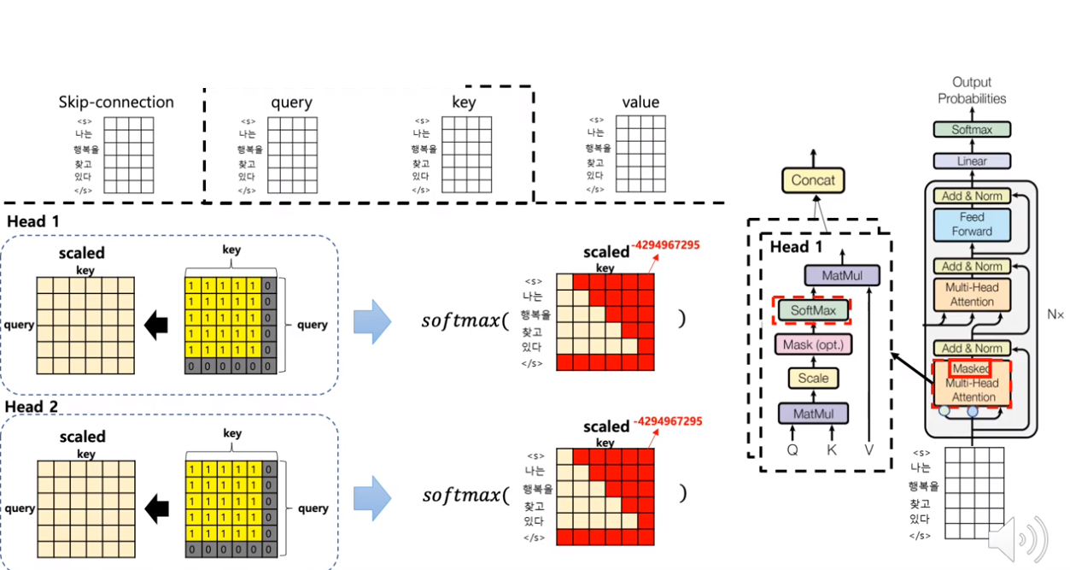
Reference : Kim Dong Hwa
1.2 Transformer Architecture
Masked Multi-Head Attention (Apply Mask)

Slide 49
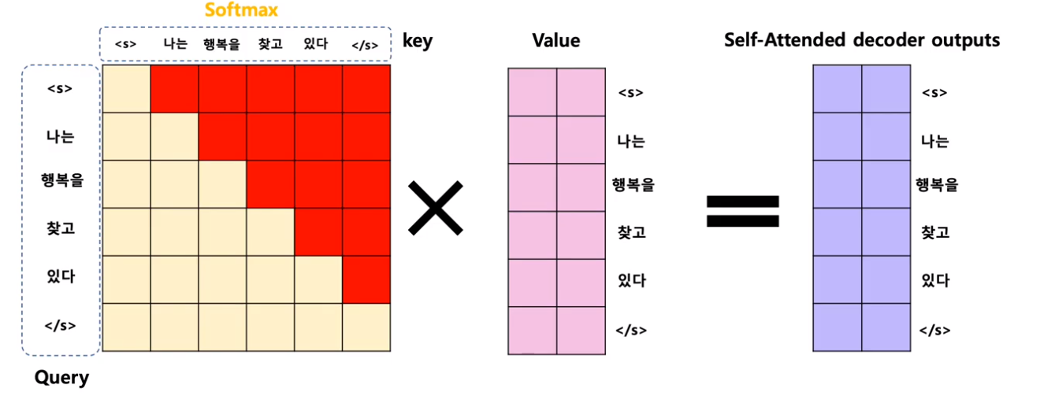
Reference : Kim Dong Hwa
1.2 Transformer Architecture
Masked Multi-Head Attention

Slide 50
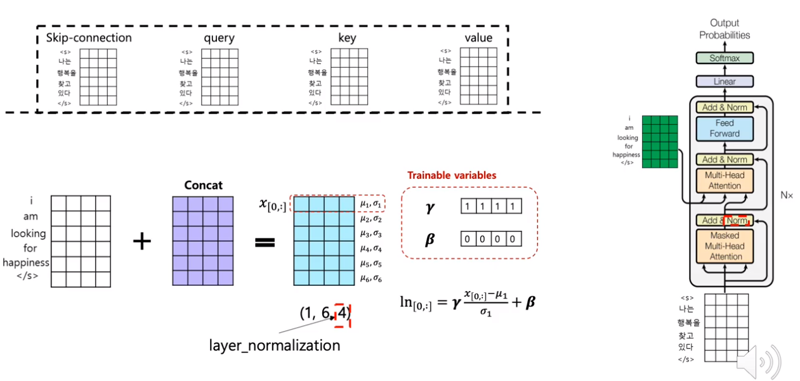
Reference : Kim Dong Hwa
1.2 Transformer Architecture
Add & Norm

Slide 51
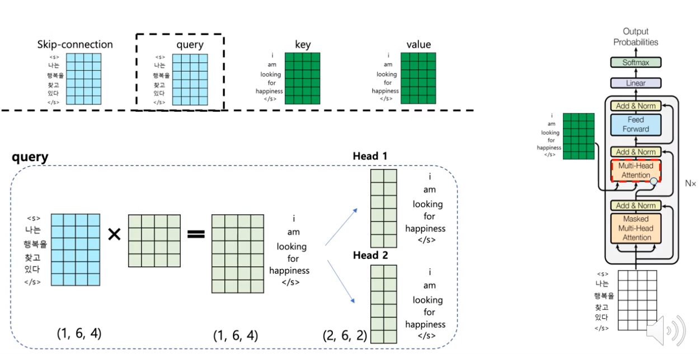
Reference : Kim Dong Hwa
1.2 Transformer Architecture
Encoder–Decoder Multi-Head Attention

Slide 52
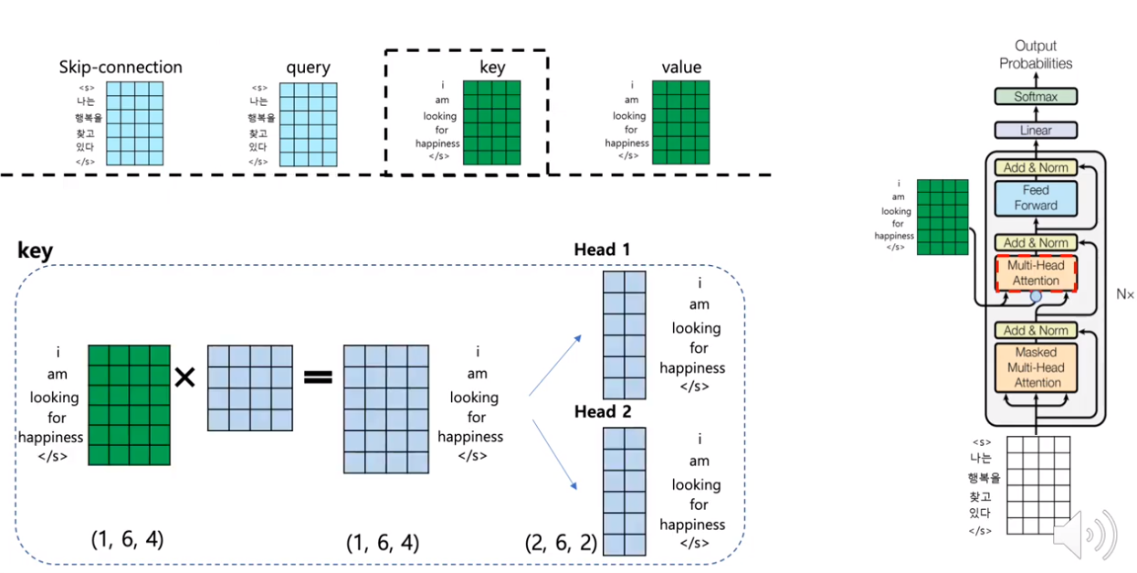
Reference : Kim Dong Hwa
1.2 Transformer Architecture
Encoder–Decoder Multi-Head Attention

Slide 53
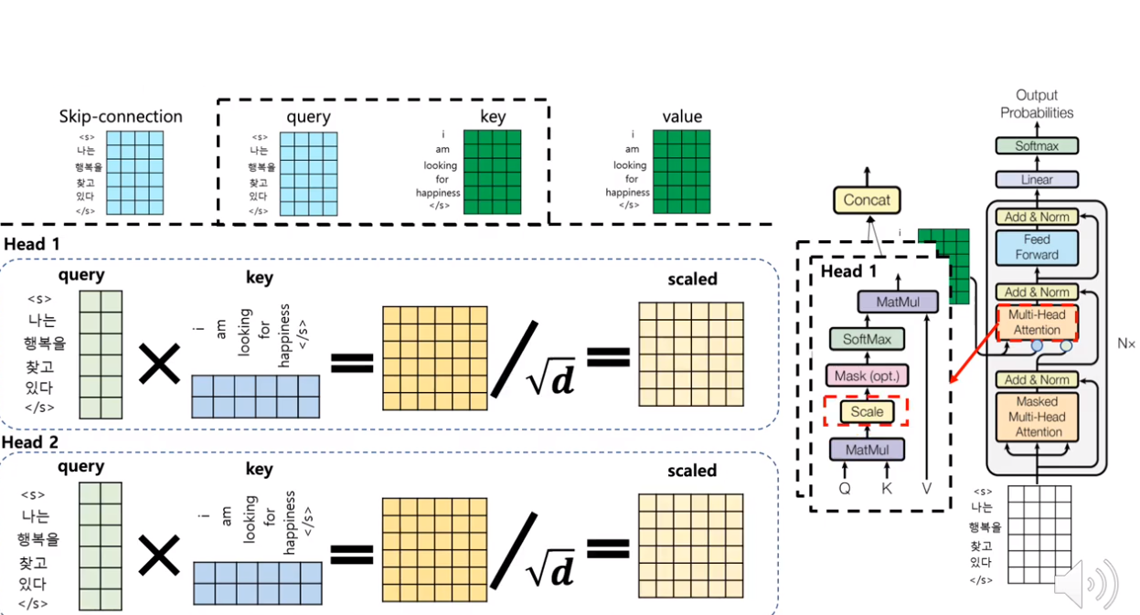
Reference : Kim Dong Hwa
1.2 Transformer Architecture
Encoder–Decoder Multi-Head Attention

Slide 54
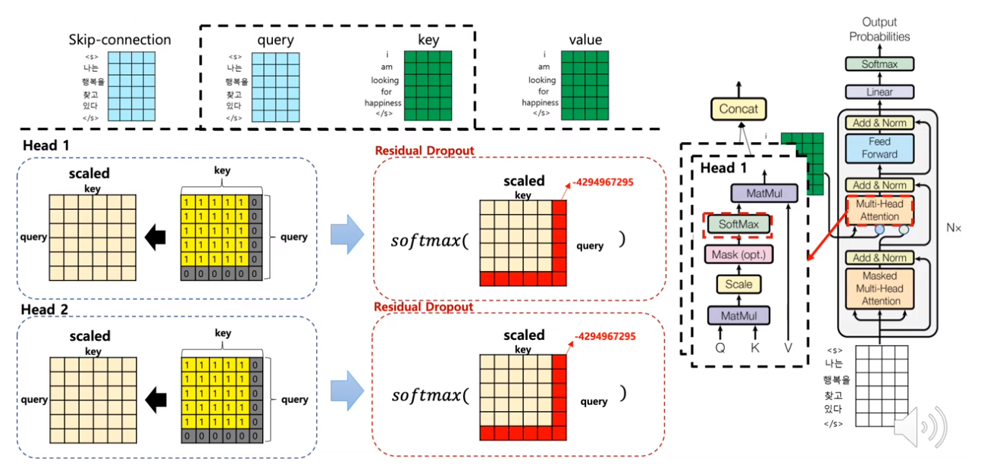
Reference : Kim Dong Hwa
1.2 Transformer Architecture
Encoder–Decoder Multi-Head Attention

Slide 55
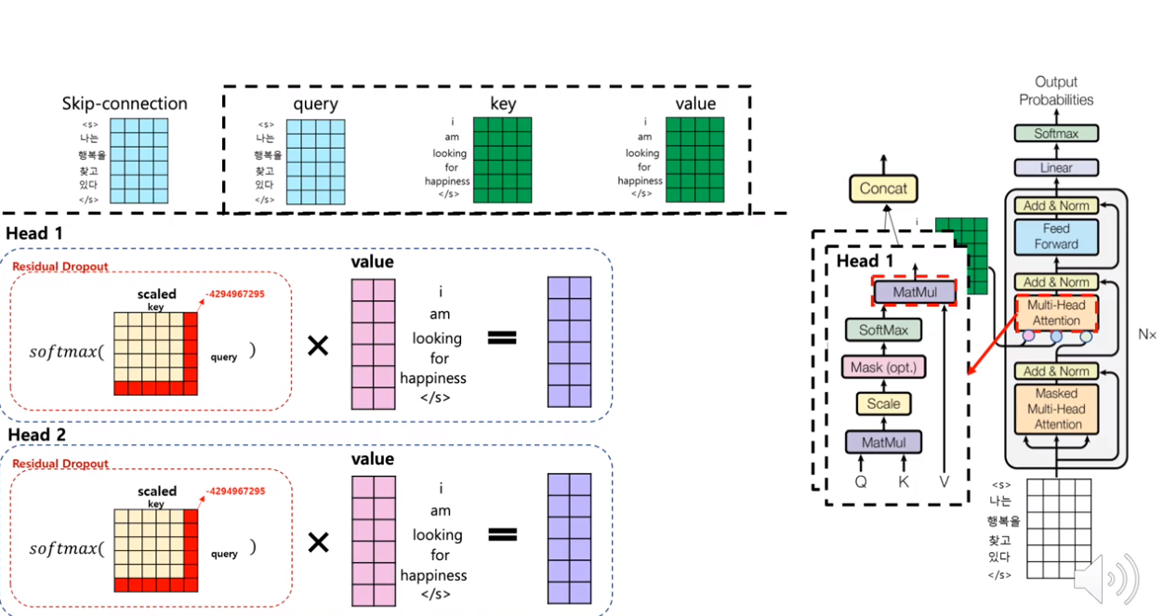
Reference : Kim Dong Hwa
1.2 Transformer Architecture
Encoder–Decoder Multi-Head Attention

Slide 56
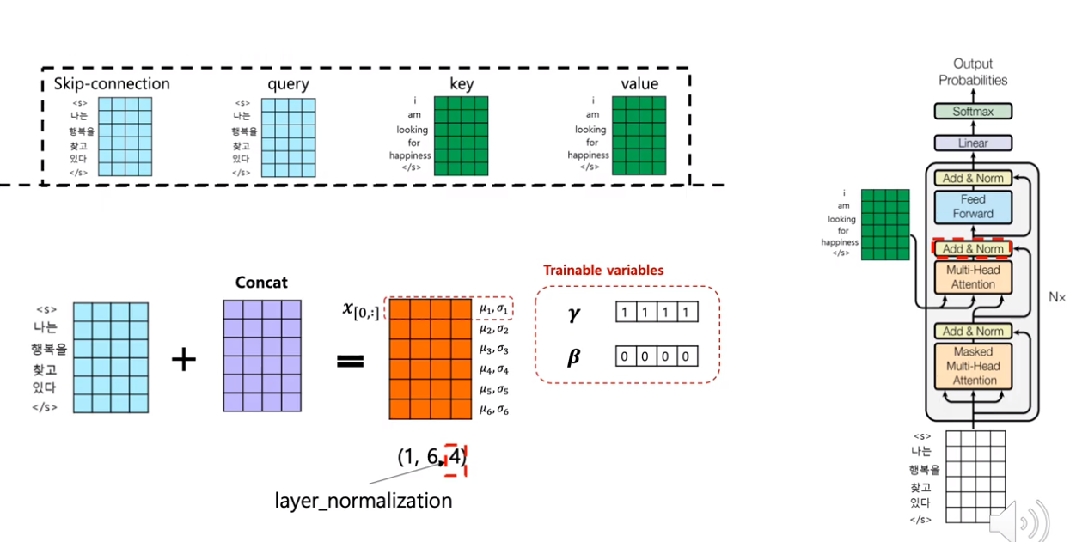
Reference : Kim Dong Hwa
1.2 Transformer Architecture
Add & Norm

Slide 57
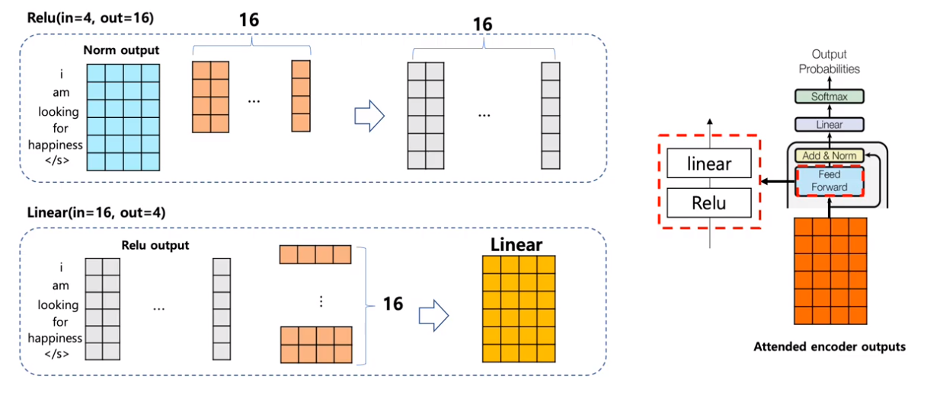
Reference : Kim Dong Hwa
1.2 Transformer Architecture
Positionwise Feed Foward

Slide 58

Reference : Kim Dong Hwa
1.2 Transformer Architecture
Positionwise Feed Foward

Slide 59

Reference : Kim Dong Hwa
1.2 Transformer Architecture
Add & Norm

Slide 60

Reference : Kim Dong Hwa
1.2 Transformer Architecture
Linear & Softmax

Slide 61

Reference : Kim Dong Hwa
1.2 Transformer Architecture
Summary

Slide 62
2.1 Word Embedding (Word Representation in ML)

Slide 63
2.1 Word Embedding (Word Representation in ML)
How to represent word in computer ?

Slide 64

2.1 Word Embedding (Word Representation in ML)
Sparse Representation (One-Hot)
… We Want Dense Representation !!

Slide 65



2.1 Word Embedding (Word Representation in ML)
Dense Representation (Word2Vec)
Skip Gram
CBOW

Slide 66


2.1 Word Embedding (Word Representation in ML)
Dense Representation (Word2Vec)
Skip Gram
CBOW

Slide 67


2.1 Word Embedding (Word Representation in ML)
Dense Representation (Improved Word2Vec)
"apple" : "ap", "app", "appl", "apple"

Slide 68

2.1 Word Embedding (Word Representation in ML)
Word Embedding with Pre-training

Slide 69
2.1 Word Embedding (Word Representation in ML)
But They can not consider contextual meaning of word

Slide 70


2.1 Word Embedding (Word Representation in ML)
I Love an Apple. It is delicious than Banana.
I Love the Apple. It is better than Samsung.
same embedding vector… is it ok?

Slide 71
2.1 Word Embedding (Word Representation in ML)
4/28 : Today, I am going to _____ , I am so happy.
4/29 : Today, I am going to _____ , I am so sad…
4/30 : Today, I am going to _____ , I am so exciting!
School, Home, Hospital, Church, Temple …
They will have similar embedding vector. Because they only consider about whether they appear at the same time
[going, to , _____ , I , am] are appear at the same time.

Slide 72




2.1 Word Embedding (Word Representation in ML)
~
~
~
~
But, think again... Is Church similar with Temple?
Is School similar with Home? …Really?

Slide 73

2.2 Embedding from Language Model (ELMo)

Slide 74

2.2 Embedding from Language Model (ELMo)
Language Model : To assign probability to sequence.
Consider previous words and Predict next word

Slide 75


2.2 Embedding from Language Model (ELMo)
Language Model : To assign probability to sequence.
Consider neighbor word
Consider previous words
Word2Vec
Language Model

Slide 76

2.2 Embedding from Language Model (ELMo)
Embedding from Language Model (ELMo)
ELMo uses 2 Language Model consisted of Multi Layer RNN(LSTM) : BiLM

Slide 77

2.2 Embedding from Language Model (ELMo)
Embedding from Language Model (ELMo)
To embed the word ”play”, ELMo uses the result of each layer
inside the dotted rectangle above as the material.

Slide 78




2.2 Embedding from Language Model (ELMo)
Embedding from Language Model (ELMo)
1. Concatenate
Forward LM & Backward LM
2. Multiply
Wight at each layer’s outputs
3. Add
Every layer’s outputs
4. Scale
by multiplying constant

Slide 79

2.2 Embedding from Language Model (ELMo)
Embedding from Language Model (ELMo)
We can use ELMo representation for downstream task with embedding
And Now, Model knows about word’s contextual meaning.

Slide 80
2.2 Embedding from Language Model (ELMo)
Embedding from Language Model (ELMo)
But, there are still a big problem
We still lack the data specific to a particular task

Slide 81

2.2 Embedding from Language Model (ELMo)
We still lack the data specific to a particular task
Text Classification

Slide 82

2.2 Embedding from Language Model (ELMo)
We still lack the data specific to a particular task
Named Entity Recognition

Slide 83

2.2 Embedding from Language Model (ELMo)
We still lack the data specific to a particular task
Machine Translation

Slide 84

2.2 Embedding from Language Model (ELMo)
We still lack the data specific to a particular task
Question & Answering

Slide 85
2.3 Unsupervised Pre-train, Supervised Fine Tune (GPT)

Slide 86

2.3 Unsupervised Pre-train, Supervised Fine Tune (GPT)
But we have a lot of unlabeled text data.

Slide 87

2.3 Unsupervised Pre-train, Supervised Fine Tune (GPT)
But we have a lot of unlabeled text data.

Slide 88
2.3 Unsupervised Pre-train, Supervised Fine Tune (GPT)
We want universal NLU Model trained unlabeled data like human
So, GPT tries semi-supervised approach with pre-train & fine tune
to solve that problem (lack of task specific dataset)

Slide 89

2.3 Unsupervised Pre-train, Supervised Fine Tune (GPT)
Unsupervised Pre-train
Unsupervised Corpus of token U = u1, u2, … , un
The maximum likelihood of maximizing a standard LM objective is:
K = window size
Theta = NN’s parameter

Slide 90

2.3 Unsupervised Pre-train, Supervised Fine Tune (GPT)
Unsupervised Pre-train
Unsupervised Corpus of token U = u1, u2, … , un
We = Embedding , Wp = Positional
P(u) is output of model (next word prediction)

Slide 91

2.3 Unsupervised Pre-train, Supervised Fine Tune (GPT)
Unsupervised Pre-train

Slide 92

2.3 Unsupervised Pre-train, Supervised Fine Tune (GPT)
Supervised Fine Tune

Slide 93


2.3 Unsupervised Pre-train, Supervised Fine Tune (GPT)
Supervised Fine Tune
Supervised Corpus of token X = x1, x2, … , xm, label = Y
pass through the linear output layer once more to predict the y value

Slide 94

2.3 Unsupervised Pre-train, Supervised Fine Tune (GPT)
Auxiliary Loss
Supervised Corpus of token X = x1, x2, … , xm, label = Y
pass through the linear output layer once more to predict the y value

Slide 95

2.3 Unsupervised Pre-train, Supervised Fine Tune (GPT)
Framework

Slide 96

3. BERT & Experiments

Slide 97

Reference : Kim Dong Hwa
3. BERT & Experiments
Pre-training

Slide 98

Reference : Kim Dong Hwa
3. BERT & Experiments
Pre-training

Slide 99

Reference : Kim Dong Hwa
3. BERT & Experiments
Pre-training

Slide 100

Reference : Kim Dong Hwa
3. BERT & Experiments
Pre-training : Segmentation

Slide 101

Reference : Kim Dong Hwa
3. BERT & Experiments
Pre-training : Segmentation

Slide 102

Reference : Kim Dong Hwa
3. BERT & Experiments
Pre-training : Segmentation

Slide 103

Reference : Kim Dong Hwa
3. BERT & Experiments
Pre-training : Segmentation

Slide 104

Reference : Kim Dong Hwa
3. BERT & Experiments
Pre-training : Segmentation

Slide 105

Reference : Kim Dong Hwa
3. BERT & Experiments
Preprocessing : Next Sentence

Slide 106

Reference : Kim Dong Hwa
3. BERT & Experiments
Preprocessing : Next Sentence

Slide 107

Reference : Kim Dong Hwa
3. BERT & Experiments
Preprocessing : Length & Mask

Slide 108

Reference : Kim Dong Hwa
3. BERT & Experiments
Preprocessing : Length & Mask

Slide 109


Reference : Kim Dong Hwa
3. BERT & Experiments
Preprocessing : 학습되는 데이터

Slide 110

Reference : Kim Dong Hwa
3. BERT & Experiments
BERT vs Transformer

Slide 111

Reference : Kim Dong Hwa
3. BERT & Experiments
BERT vs Transformer

Slide 112

Reference : Kim Dong Hwa
3. BERT & Experiments
BERT vs Transformer

Slide 113

Reference : Kim Dong Hwa
3. BERT & Experiments
BERT vs Transformer

Slide 114

Reference : Kim Dong Hwa
3. BERT & Experiments
BERT vs Transformer

Slide 115

Reference : Kim Dong Hwa
3. BERT & Experiments
Token Embedding

Slide 116

Reference : Kim Dong Hwa
3. BERT & Experiments
Segment Embedding

Slide 117

Reference : Kim Dong Hwa
3. BERT & Experiments
Positional Embedding

Slide 118

Reference : Kim Dong Hwa
3. BERT & Experiments
Norm

Slide 119

Reference : Kim Dong Hwa
3. BERT & Experiments
GELU

Slide 120

Reference : Kim Dong Hwa
3. BERT & Experiments
Forwarding

Slide 121

Reference : Kim Dong Hwa
3. BERT & Experiments
Loss

Slide 122

Reference : Kim Dong Hwa
3. BERT & Experiments
Next Sentence Loss

Slide 123

Reference : Kim Dong Hwa
3. BERT & Experiments
Next Sentence Loss

Slide 124

Reference : Kim Dong Hwa
3. BERT & Experiments
Mask Loss

Slide 125

Reference : Kim Dong Hwa
3. BERT & Experiments
Mask Loss

Slide 126

Reference : Kim Dong Hwa
3. BERT & Experiments
Fine Tune

Slide 127

Reference : Kim Dong Hwa
3. BERT & Experiments
Fine Tune

Slide 128

Reference : Kim Dong Hwa
3. BERT & Experiments
Experiment Result

Slide 129


Reference : Kim Dong Hwa
3. BERT & Experiments
Experiment Result

